Slide 1
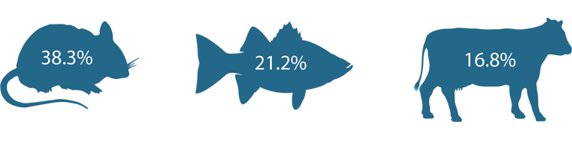

Large Scale Classification
P101 - s102
Group-3
Edgar Gil 205870 - Daniel González 184702

Slide 2
Index
What we want to make
Steps taken before
Results in models tested(chosen)
Model
Dataset
Modifications
Methodology
Accuracy in models tested
Training and test resnet
Results resnet101
Results vgg11
Conclusions

Slide 3
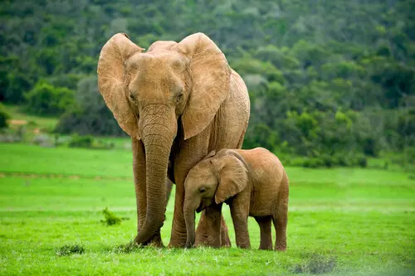


1-What we want to make
The problem
To be able to classify a large number of animals simply by their own characteristics by analyzing the properties of the photograph.
1

Slide 4
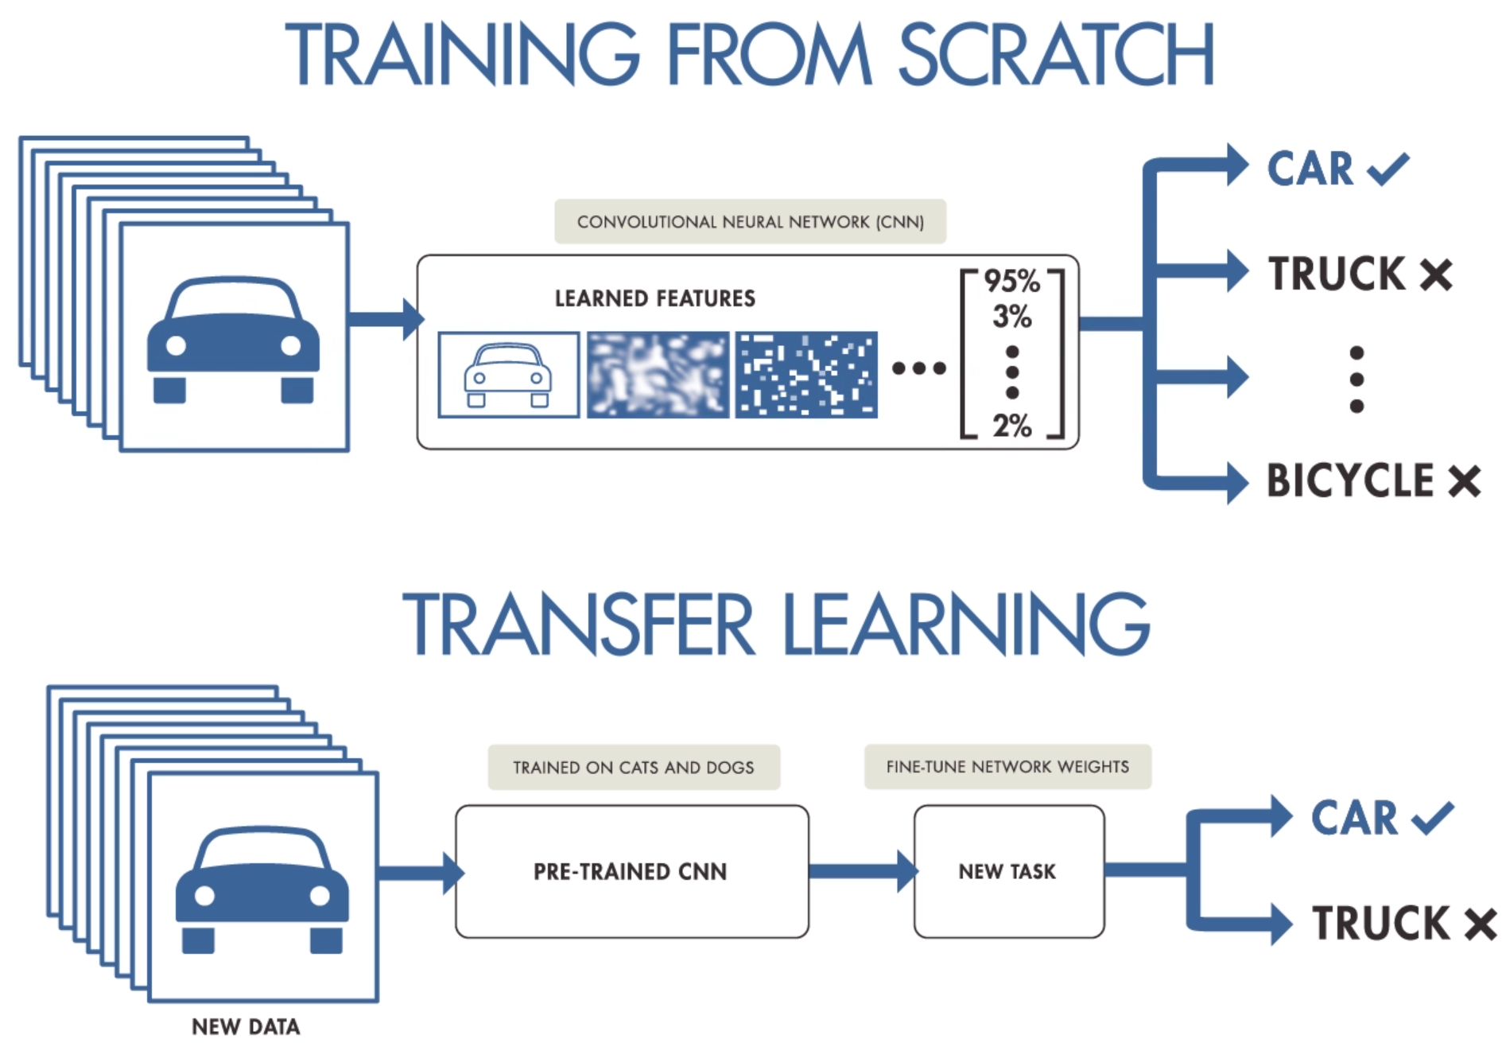
The Goal
Our goal is to be able to implement a system that allows us to classify images of animals by category.
There are two possible ways to reach the same goal:
Learn the features from scratch
Do transfers learning in a large model.(not animals)
2

Slide 5
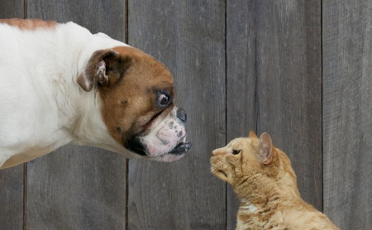
2-Steps taken before
We start with the serial dataset: Dogs vs. Cats Redux: Kernels Edition[2]. And a example from internet with resnet152 .
Problems:
-Code doesn't work.
-Database of the example missing.
-Model resnet152 too large for 1 epoch (3 weeks)
Solutions:
-Combine the example with documentation pytorch
-Find another database with cats and dogs and prepare for our system.
-Try new models
3

Slide 6
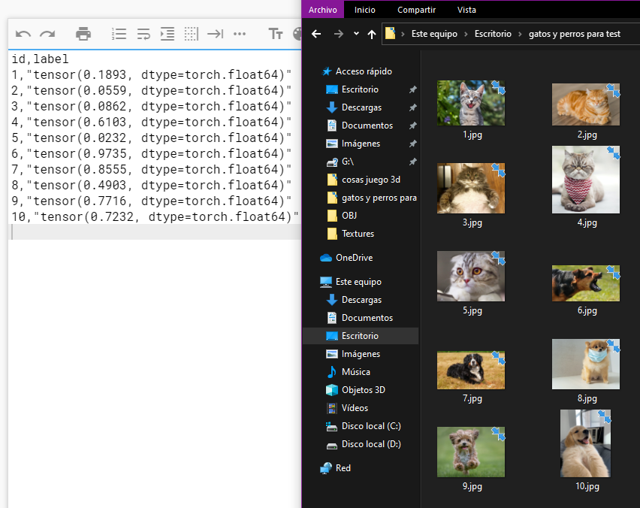
Steps taken before
Now our code works we also tried different models like vgg, alexnet and resnet101.
So we started to adapt that model so that it can classify more types of animals.
As we investigated, the most used models for photo classification are alexnet, vgg and resnet. [1]
4

Slide 7

Steps taken before
Training from scratch mention
Wining models -> Vgg11 and resnet101.
Doesn’t learn for any combination of parameters or epochs.
We tried until 200 epochs.
Probably because of the size of the training dataset.
5

Slide 8
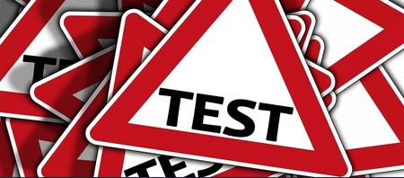
Steps taken before
Things to mention:
-If we use the pin_memory=true we overload the memory of the graph with large datasets and it does not allow to continue the execution.
-resnet152 It takes 3 weeks to train an epoch due to its number of parameters.
-resnet18 It a large time to train an epoch due to its number of parameters.
-resnet101 need a Linear(1000, 5) wich 5 means the number of classes
-Vgg11 need in the classifier a Linear(4096, 5) and 132 M parameters. So much slow vs resnet 101.
6

Slide 9
3-Results in models tested(chosen)
From scratch
Download no train
Download an trained Model
*For 2 clases (cat and dog)*
Model
Resnet101
55%
15%
98%
squeezenet1_1
15%
0%
42%
alexnet
32%
0%
94%
VGG11
45%
0,05%
96%
Other versions of the same models have been tried but different amounts of layter (example VGG13) but none with better results than those mentioned in the table.
We decide the final model is Resnet101.
7

Slide 10
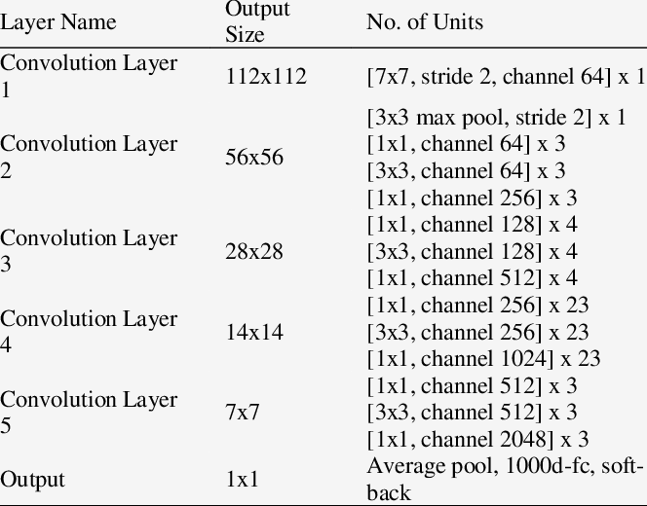
4-Model
Resnet101 is a convolutional neural network .The model consists of 347 layers and in total there are 44,654,504 parameters.
It allows us to carry out training with our dataset within an optimal time for the practice.
It is also a good choice when classifying images according to the examples found. This model is downloaded using PyTorch models.
8

Slide 11
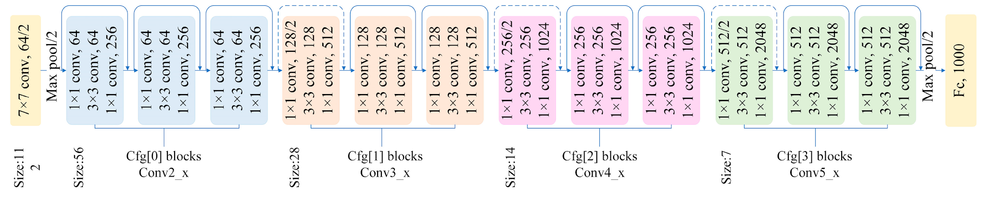
Model architecture
Loss function: Cross Entropy Loss
Optimizer: Adam
Batch size: 128
Learning rate: 1e-4
Epochs: 200 for model from scratch and 10 for transfer learning
For transfer learning need normalize the images with mean=[0.485, 0.456, 0.406] and std=[0.229, 0.224, 0.225]
9

Slide 12
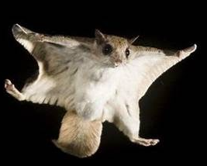
5-Dataset
Our dataset is a subset of photos of animals from the Kaggle dataset animals10 And we crop it to have the same number of photos.
Dog | Horse | Elephant | Butterfly | Chicken
Cat | Cow | Sheep | Squirrel | Spider
Squirrel | Horse | Elephant
Butterfly | Sheep
For each animal we have left 1000 images for training, 300 for validation and 140 for test.
Source del dataset : https://www.kaggle.com/alessiocorrado99/animals10
10

Slide 13
6-Modifications
Several variant resnet models have been tested (with more parameters) but the training time increased to a level that does not allow us to carry out tests in a consistent time, in addition to that there was no notable improvement in the result.
It was tried to change the optimizers and their parameters.
Change in the number of epochs and learning rates.
Added:
Record in CSV of the test results for the 5 categories, giving the percentage of success.
The percentage of success for each category is printed during the training validity.
We print the characteristics of the model at the beginning of the training (as it is formed).
Attempt to adapt the learning rate in increasing epochs.
11

Slide 14
7-Methodology
Training from scratch
Animals10 DATASET → (5 animals)
Results after train-validate and test
Transfer learning
PreTrained model from pytorch
Animals10 DATASET → (5 animals)
Results after train-validate and test
12

Slide 15
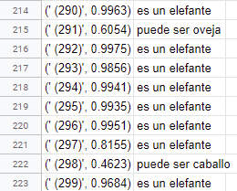
Methodology
How we test the results
We export the data to a csv, with the percentage of being each anima
with the percentage of the selected animal and its category and then we check them quickly by following these numbers.
from 1 to 137 + 698, 699, 700 are squirrels
from 138 to 277 are horses
from 278 to 417 are elephants
from 418 to 557 are butterflies
from 558 to 697 are sheep
12

Slide 16
8-Accuracy in models tested
From scratch
Download no train
Download train
*For 5 clases *
Model
Resnet101
38%
15%
99%
squeezenet1_1
4%
0%
38%
alexnet
14%
0%
92%
VGG11
25%
0,05%
97%
Seeing the results we decided to stay with resnet101
13

Slide 17
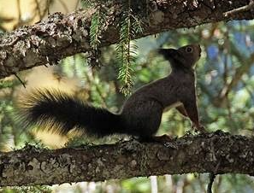
9-Training and test resnet
Training from scratch
After several attempts with different models, learnings rates, and epochs we have not been able to go beyond 45% accuracy and 1.01 error.
Giving this option as little as final when presenting the work.
Transfer learning
By downloading a pre-trained model from the PyTorch website, we have been able to transfer between 98 and 99% accuracy through transfer learning when classifying the categories of animals mentioned.
14

Slide 18
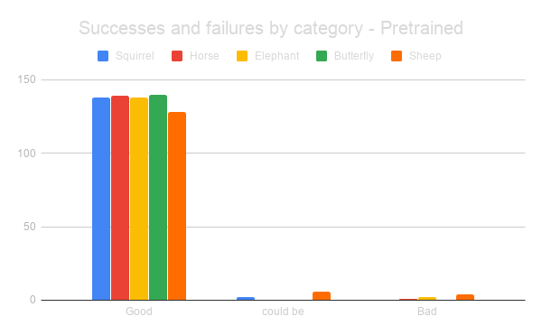
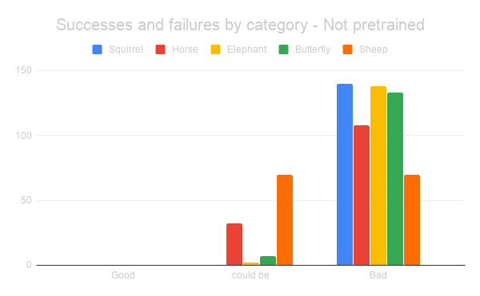
10-Results resnet101
"It can be" means that the percentage of categorization of the correct animal is the highest, but even so, it does not exceed the limit of the marked decision to mark it as a "certain" decision. (> 55%)
15

Slide 19
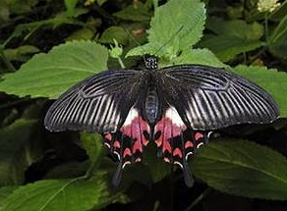
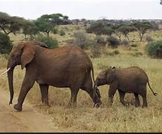
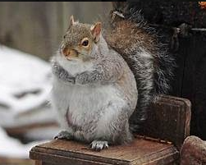
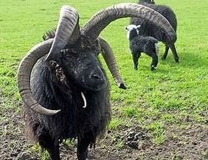
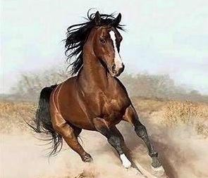
Good classification
Elephants have recognizable color and skin markings
Squirrels have long tails and short fur along with the shape of the head
Sheep have more characteristics since they are of various hair colors and not all of them have horns
Horses have a detectable coat shape and texture only by changing their color.
A butterfly's patterns are based on very colorful wings and quite similar shapes
This is because our system has been able to extract enough characteristics from the trained dataset. Due to this it is able to classify the 5 categories with a high percentage of success (99%)
16

Slide 20
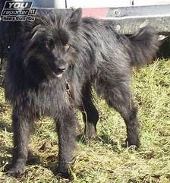
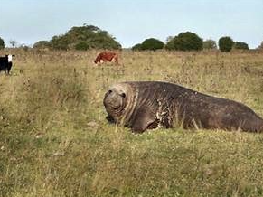
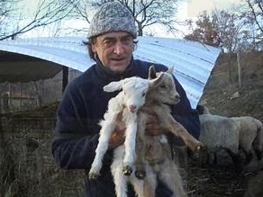
(some funny mistakes)
yes, currently this is a sheep
and this is… ¿an elephant?
can you see the horse in this picture ?
17

Slide 21
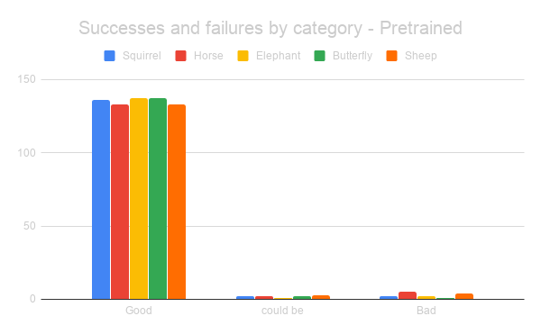
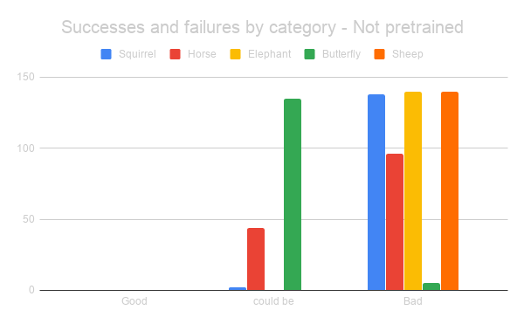
11-Results VGG11
"It can be" means that the percentage of categorization of the correct animal is the highest, but even so, it does not exceed the limit of the marked decision to mark it as a "certain" decision. (> 55%)
18

Slide 22
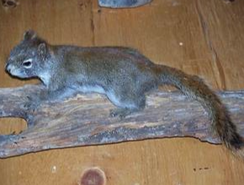
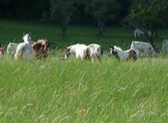
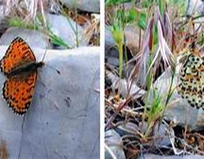
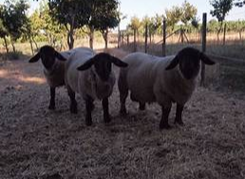
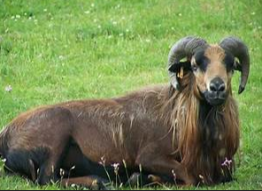
(some funny mistakes)
What a beautiful elephant
A herd of sheep .. wait a moment!
This must be a flying squirrel, right?
A herd of elephants looking curiously
A nice horse resting in the meadow
19

Slide 23

12-Conclusions
We can see how the attempt to enter the model from scratch has not given optimal results that we could use in any system, this is surely due to a lack of data in the training dataset, not allowing us to collect enough characteristics to classify our animals.
While doing transfer learning we can classify the categories with great precision even if the initial model is not focused on animals.
20

Slide 24
Links and resources
[1] Comparison of Deep Transfer Learning Techniques. https://www.mdpi.com/2571-5577/3/2/20/pdf
[2] Dataset https://www.kaggle.com/c/dogs-vs-cats-redux-kernels-edition/data
Troubleshooting:
https://discuss.pytorch.org/t/runtimeerror-element-0-of-variables-does-not-require-grad-and-does-not-have-a-grad-fn/11074
https://www.arxiv-vanity.com/papers/1711.04291/

